Slide 1
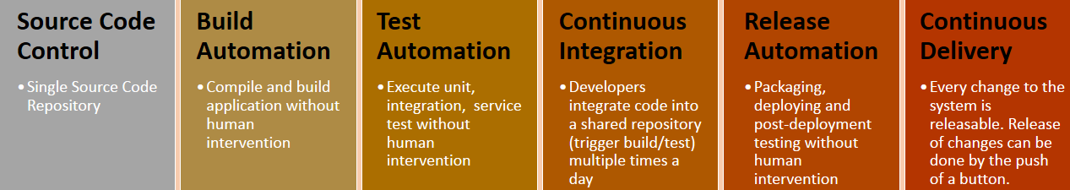









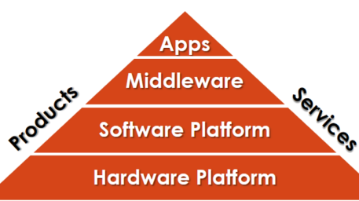
















































New Relic
ruxit
npm
Ansible
rex
Datadog
Synaptic
RedMine
Market Leader
(Gartner/Forrester)

